Slide 1
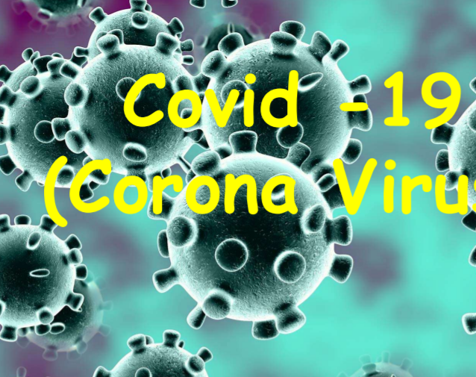
THE COVID-19 STRAIN: PREVENTION, PRECAUTIONS AND PROTOCOLS
DENNIS ADU-GYASI
FELLOW, WEST AFRICA POSTGRADUATE COLLEGE OF MEDICAL LABORATORY SCIENCE
INFECTIOUS DISEASE, IMMUNOLOGIST AND TEST METHOD VALIDATION EXPERT
Website: www.adugyasidennis.com
Twitter, Facebook and Instagram: adugyasidennis
Phone: +233244888366

Slide 2

Introduction

Slide 3
SARS COV-2 and COVID-19
The Severe Acute Respiratory Syndrome Coronavirus 2 (SARS-CoV-2) first broke out in Wuhan (China) in December 2019 and subsequently spread worldwide.
Coronavirus (CoV) is a large family of viruses that cause afflictions ranging from the common cold to more severe pathologies such as Middle East Respiratory Syndrome (MERS-CoV) and Severe Acute Respiratory Syndrome (SARS-CoV).
A novel coronavirus (nCoV) is a new strain that has now been identified in humans.

Slide 4
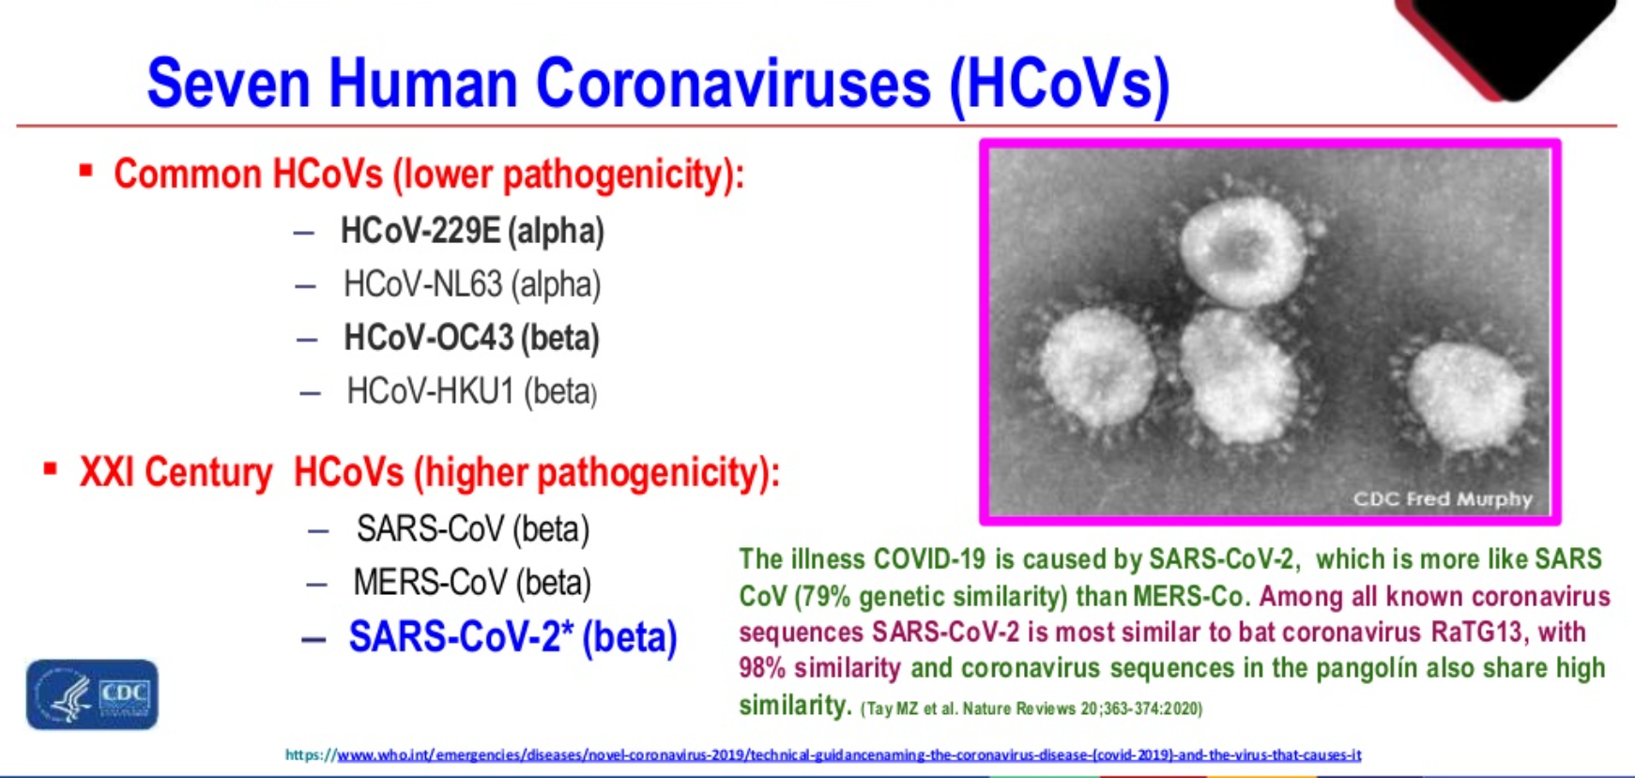

Slide 5
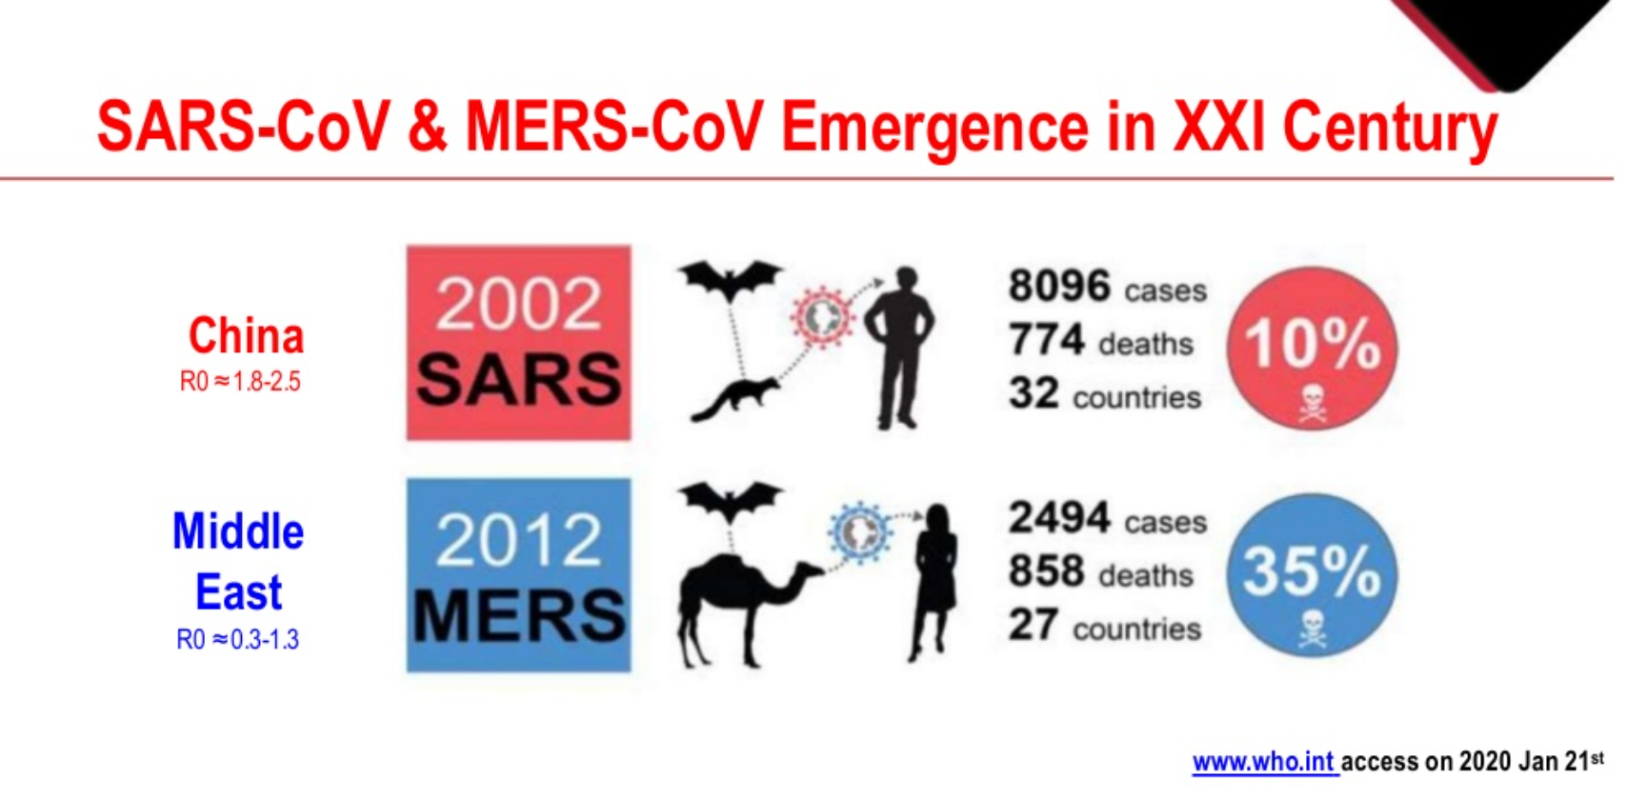

Slide 6
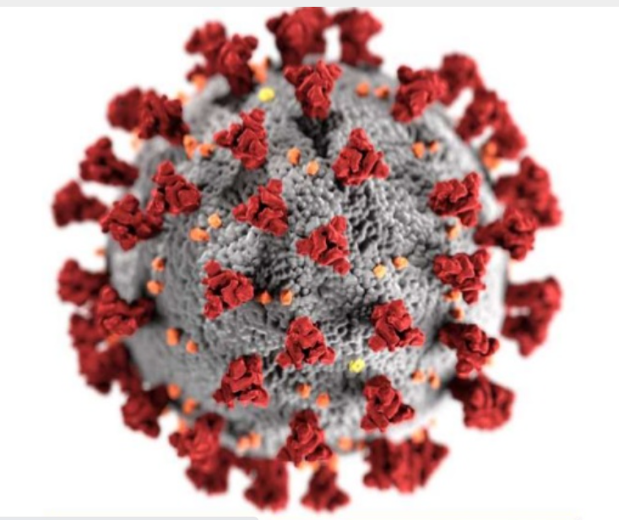
Ultrastructural morphology of Coronaviruses

Slide 7
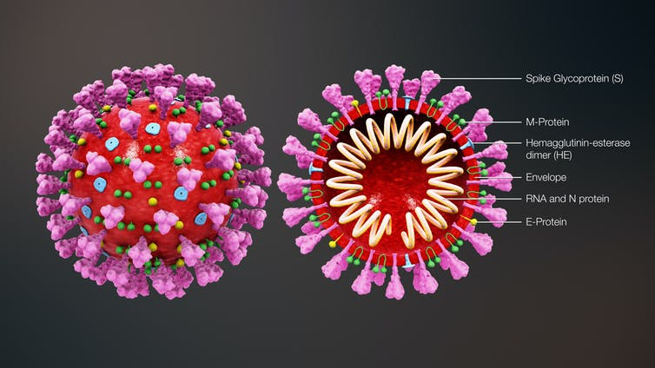
Cross Sectional View of Coronaviruses

Slide 8
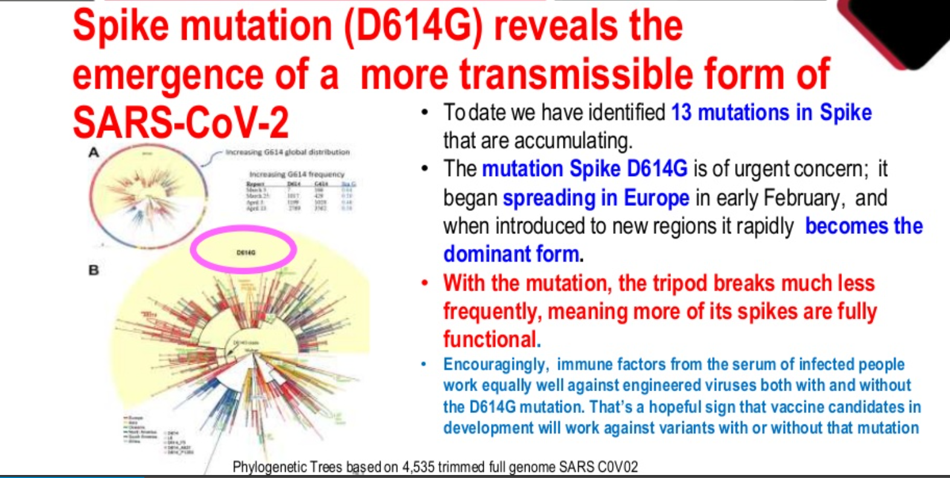
Most of the mutations occur in the gene making the Spike protein
Whenever the strain is introduced in a population or new region, it spreads rapidly and become the dominant form
Mostly the mutation makes the virus obtain fully functional spike proteins that increase their ability to infect.
This makes them more contagious.

Slide 9
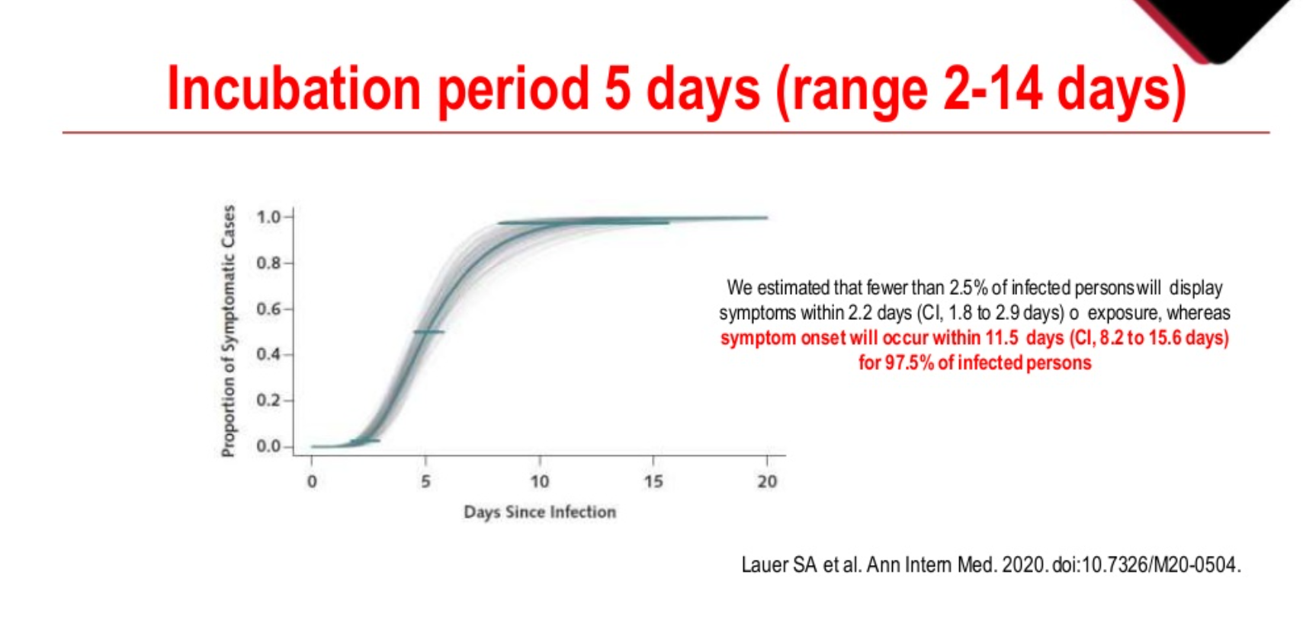

Slide 10
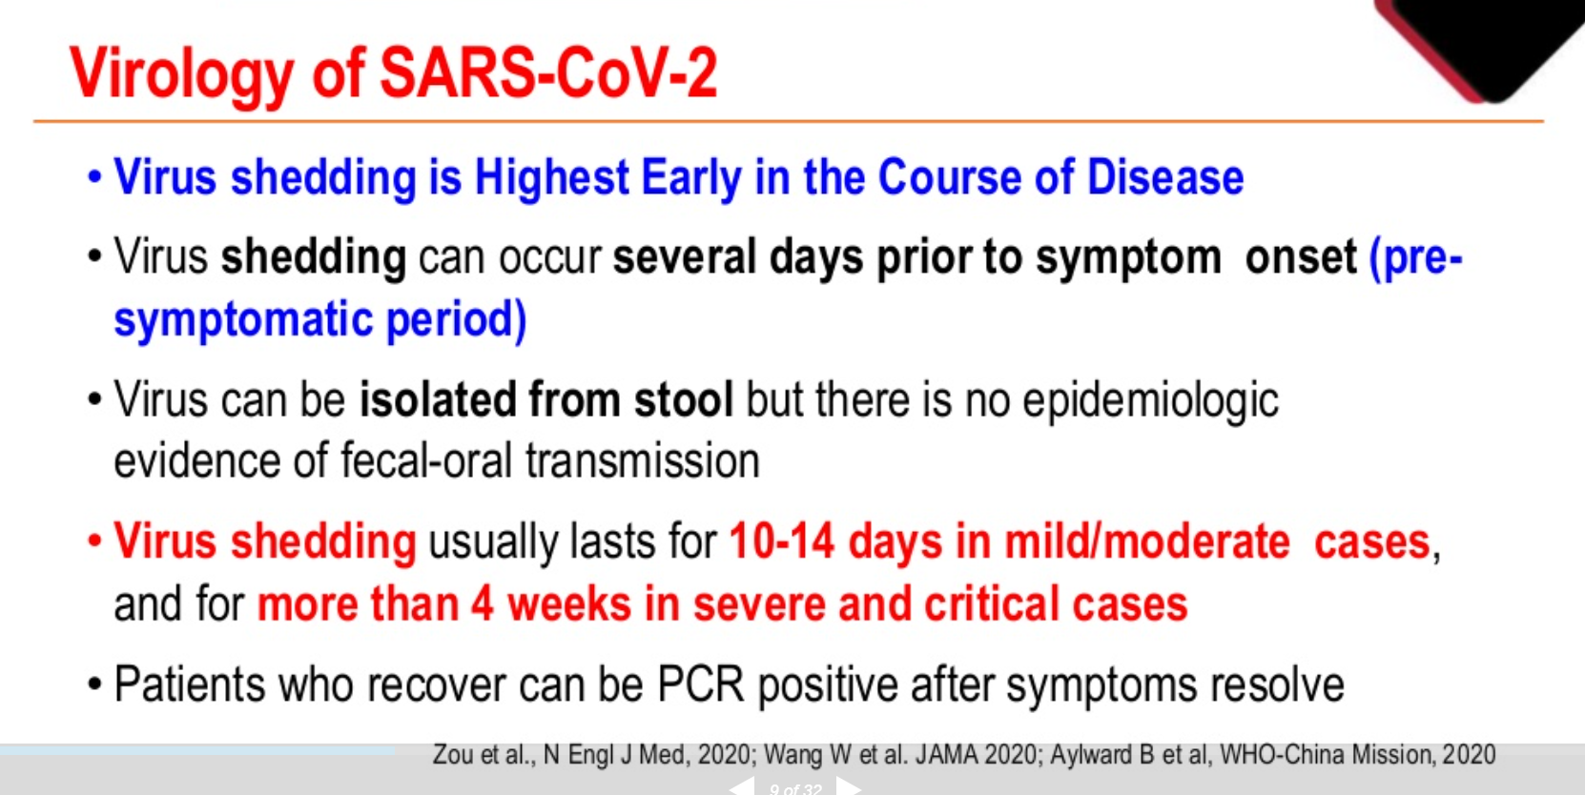

Slide 11
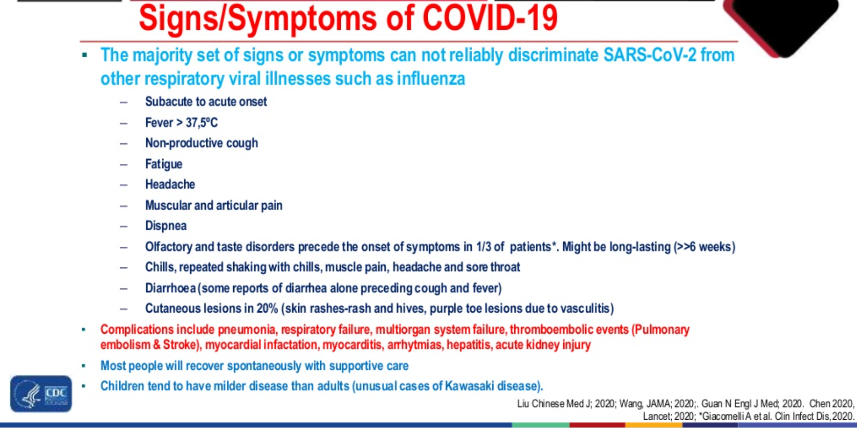

Slide 12
Other identified symptoms
Myocarditis and myocardial injury
Myocardial Infarction
Heart Failure Arrhythmias
Stroke
Hepatitis
Acute Kidney Injury
Skin Manifestation

Slide 13
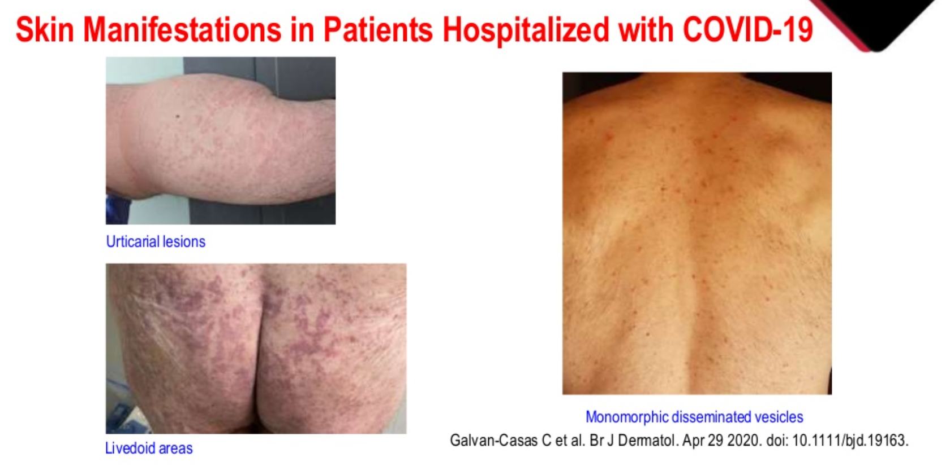

Slide 14
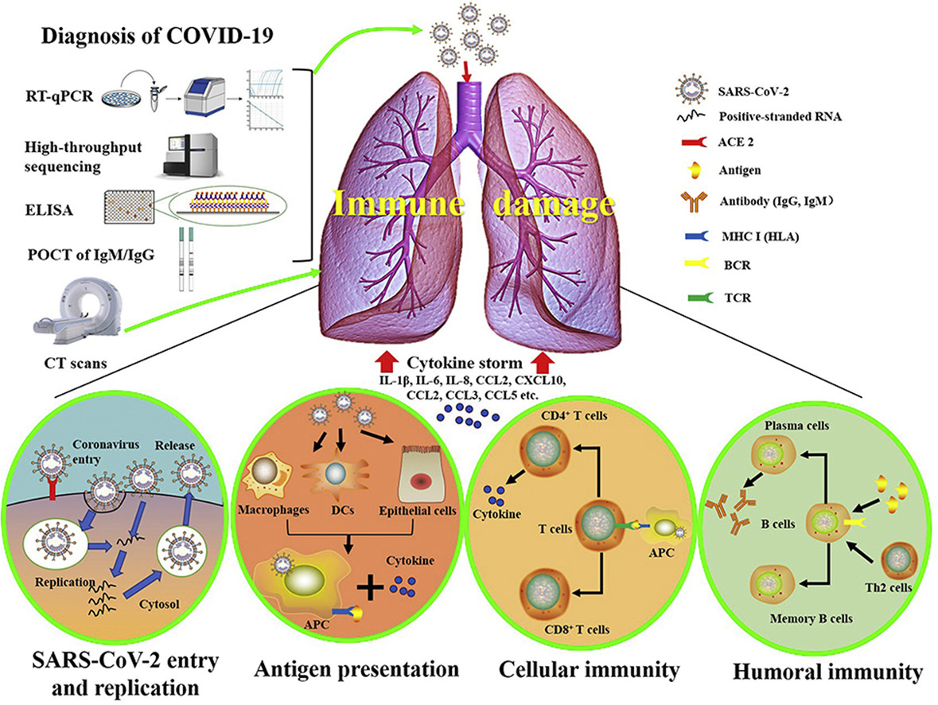

Slide 15
Gold Standard: Polymerase Chain Reaction (PCR)

Slide 16
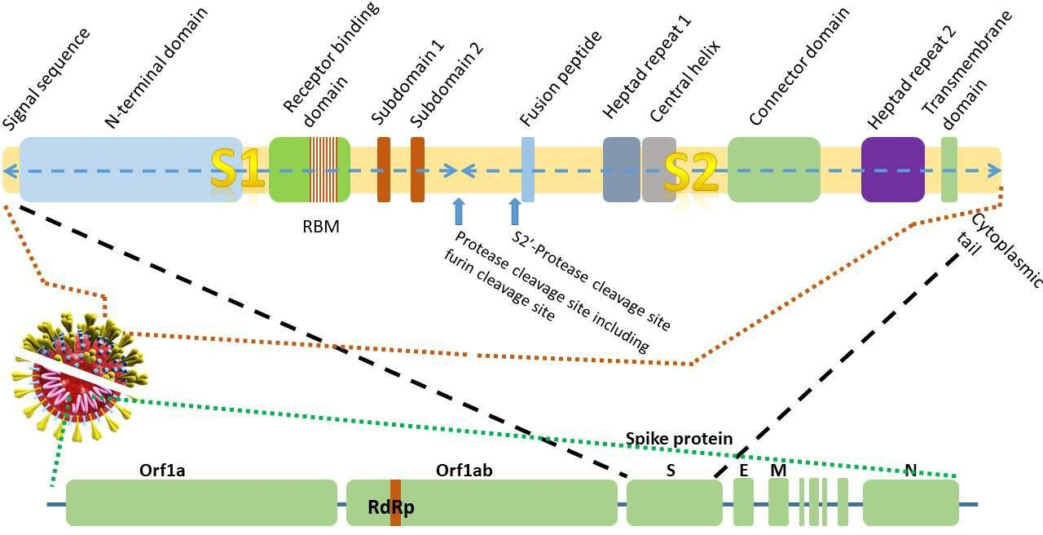
The Genomic Structure of the virus

Slide 17
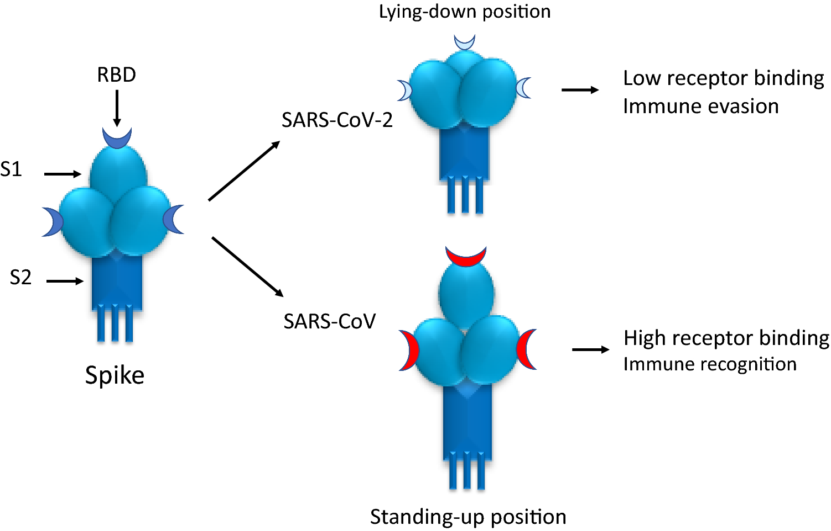

Slide 19
The Methods identify;
S Gene
Envelope Gene
Nucleocapsid Protein
RdPd gene in the ORF1ab
Diagnostic RT-PCR test is based on the RNA-dependent RNA polymerase (RdRp) gene of the ORF1ab sequence, E gene, N gene, and S gene of the SARS-CoV-2 genome

Slide 20
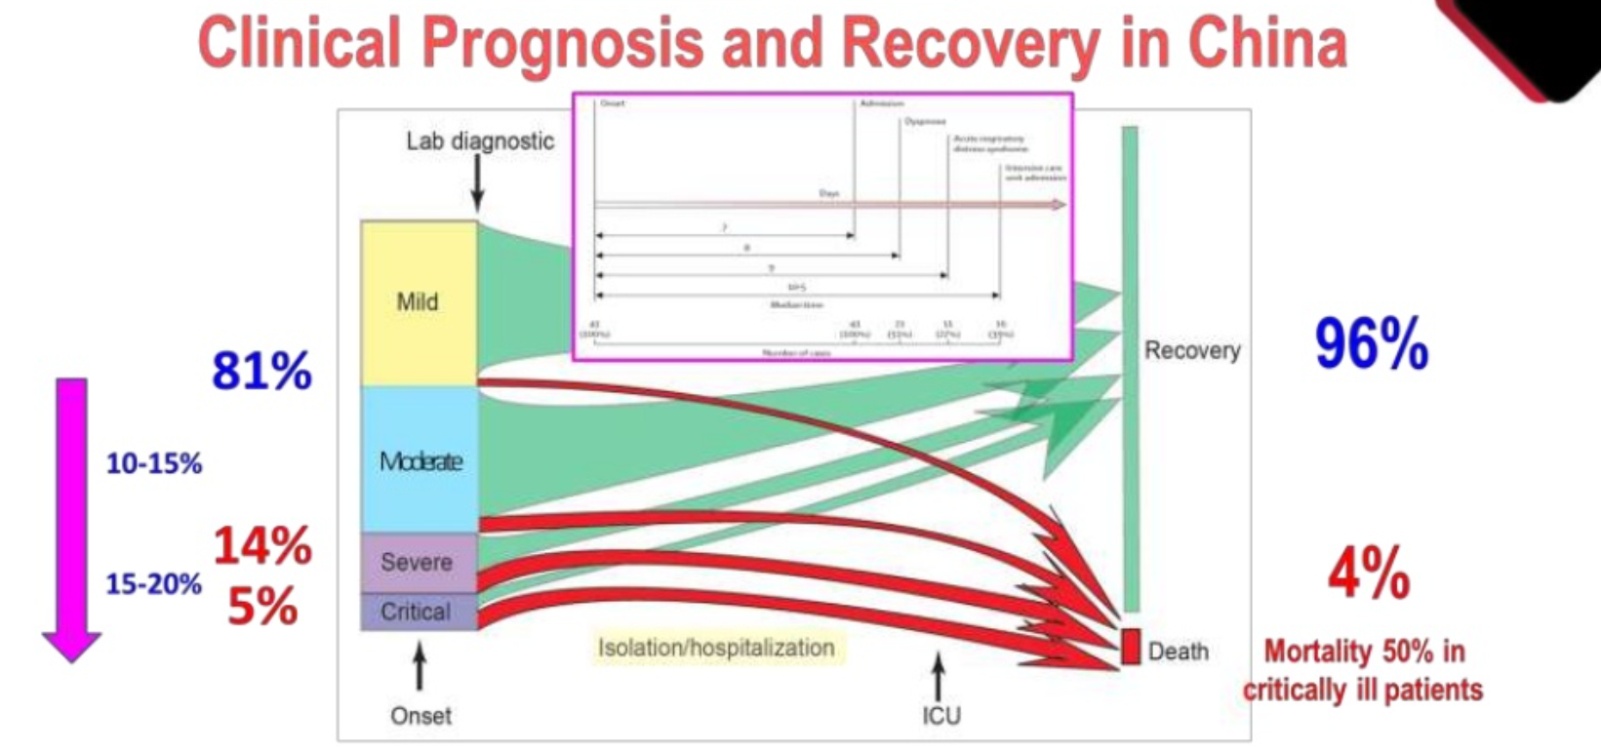

Slide 21
THE NEW STRAIN OF SARS COV-2

Slide 22
On December 14, U.K. announced a new variant of COVID-19, called B.1.1.7
The virus constantly changes through mutation leading to the emergence of new variants. There are about 4000 mutations in the spike protein.
There are about 07 new strains reported including those from South Africa and Brazil.
The UK suggests that this variant is significantly more transmissible than previously circulating variants, with an estimated increased transmissibility of up to 70%

Slide 23
Implication for Public Health
Most mutations that emerge will not provide selective advantage to the virus.
Some mutations or combinations of mutations may provide the virus with a selective advantage, such as increased transmissibility through an increase in receptor binding or the ability to evade the host immune response by altering the surface structures recognised by antibodies.
Previous investigation of the D614G variant identified only increased cellular infectivity, there was no identifiable effect on infection severity or outcome

Slide 24
Implications for Laboratory Diagnosis
The UK reports that the deletion 69-70 in the spike protein of the variant causes a negative result from S-gene RT-PCR assays applied in some laboratories in the UK.
Assays targeting the S-gene are not widely used for primary detection.
Relying only on the S-gene for primary detection of SARS-CoV-2 infection using RT-PCR is not recommended because mutations are more likely to occur in this gene.
Ghana targets at least TWO genes including the ORF1ab (RdRp) gene.

Slide 26
The Genomic Structure of the virus

Slide 27
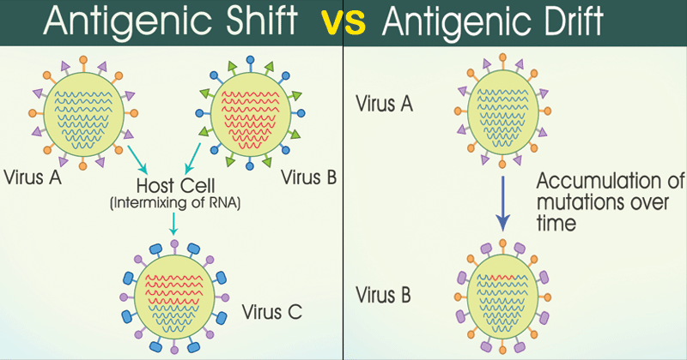

Slide 28
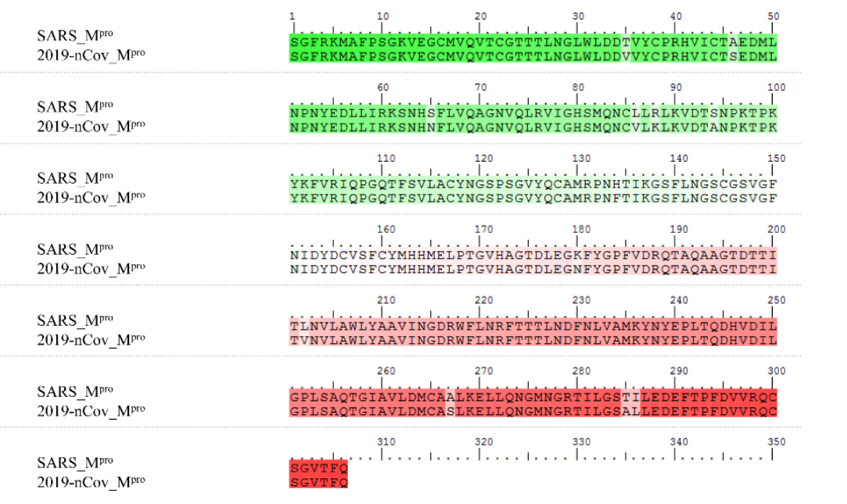
Sequence alignment of 2019-nCov Mpro and SARS Mpro

Slide 29
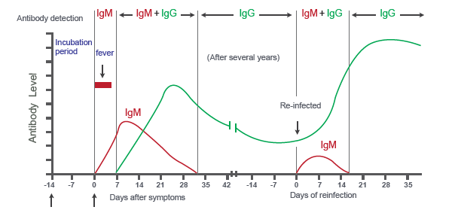
Immunity/Immunization

Slide 30
COVID-19 in Ghana and our story

Slide 32
New variant of SARS COV-2 in Ghana?

Slide 33
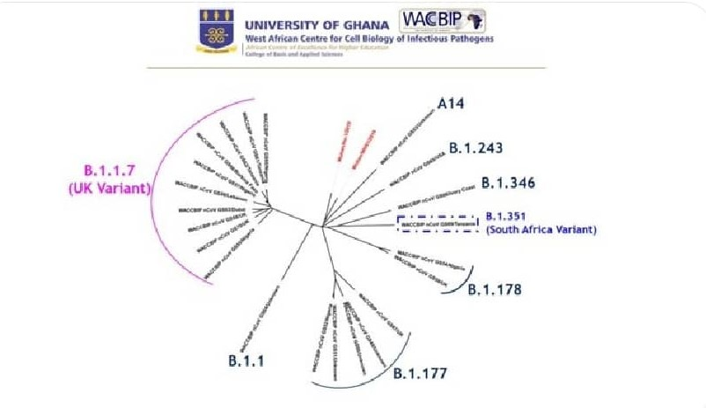
Identified New Stains at the airport among travelers

Slide 34
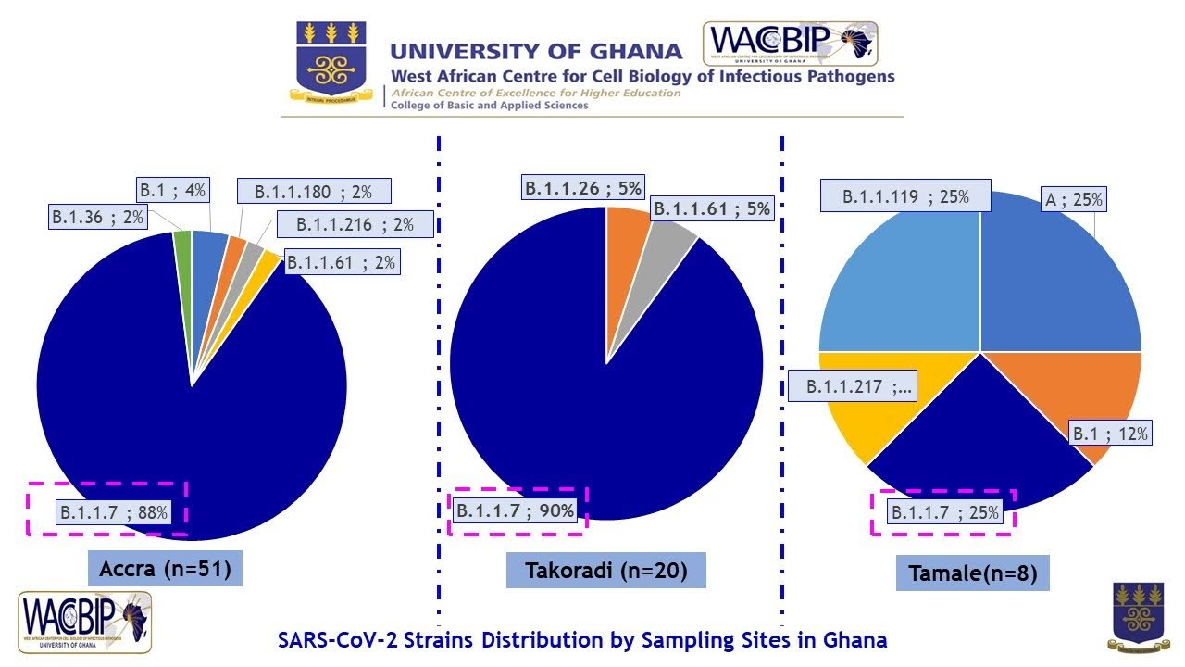

Slide 35
PREVENTION

Slide 36
Preventive interventions
To prevent the spread of COVID-19:
  Clean your hands often. Use soap and water, or an alcohol-based hand rub.
  Maintain a safe distance from anyone who is coughing or sneezing.
  Wear a mask when physical distancing is not possible.
  Don’t touch your eyes, nose or mouth.
  Cover your nose and mouth with your bent elbow or a tissue when you cough or sneeze.
  Stay home if you feel unwell.
  If you have a fever, cough and difficulty breathing, seek medical attention.

Slide 37
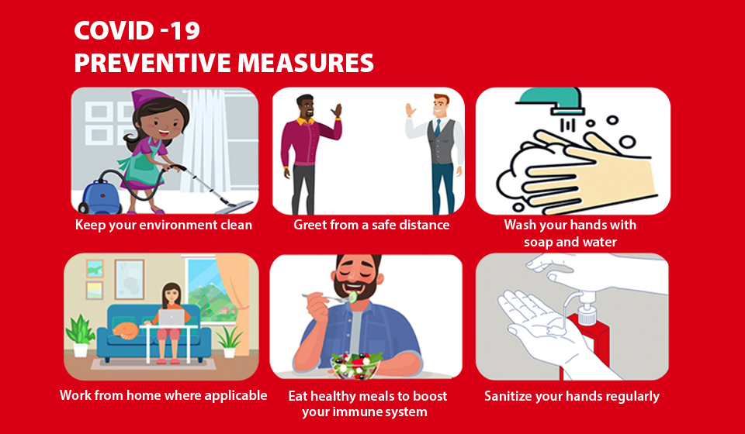
https://www.zenithbank.com.gh/coronavirus/preventive-measures/

Slide 38
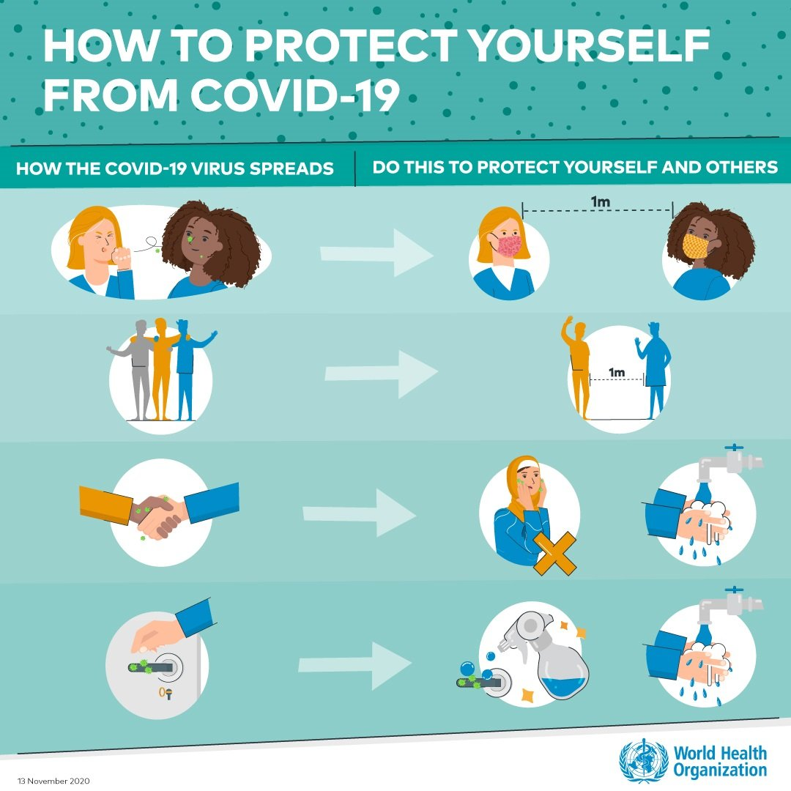

Slide 39
Vaccines
Several different types of potential vaccines for COVID-19 are in development, including:
Inactivated or weakened virus vaccines, which use a form of the virus that has been inactivated or weakened so it doesn’t cause disease, but still generates an immune response.
Protein-based vaccines, which use harmless fragments of proteins or protein shells that mimic the COVID-19 virus to safely generate an immune response.
https://adugyasidennis.com/index.php/2020/12/30/vaccine-conspiracies-covid-19-vaccines-are-not-spared/

Slide 40
Vaccines cont.
Several different types of potential vaccines for COVID-19 are in development, including:
Viral vector vaccines, which use a virus that has been genetically engineered so that it can’t cause disease, but produces coronavirus proteins to safely generate an immune response.
RNA and DNA vaccines, a cutting-edge approach that uses genetically engineered RNA or DNA to generate a protein that itself safely prompts an immune response.
https://adugyasidennis.com/index.php/2020/12/30/vaccine-conspiracies-covid-19-vaccines-are-not-spared/

Slide 41
RNA vaccines: COVID-19 mRNA vaccines give instructions for our cells to make a harmless piece of what is called the “spike protein.”
The spike protein is found on the surface of the virus that causes COVID-19 (https://www.cdc.gov/coronavirus/2019-ncov/vaccines/different-vaccines/mrna.html).
DNA vaccines: DNA vaccine consists of delivering genes or fragments of it, encoding immunogenic antigens to the host’s cells by using DNA plasmids as a vector. This approach induces both humoral and cell-mediated immune responses efficiently.

Slide 42
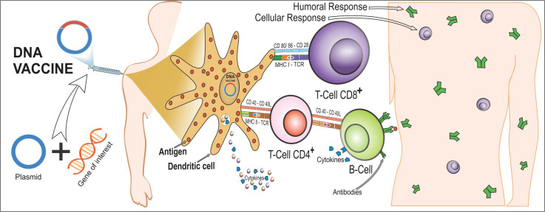
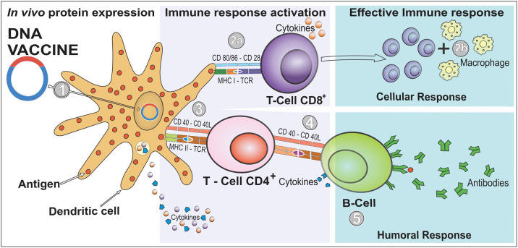
COVID-19 DNA Vaccines and mechanism

Slide 43
Possible impact on vaccine match and effectiveness
The new variant has mutations to the spike protein that the three leading vaccines are targeting.
However, vaccines produce antibodies against many regions in the spike protein, so it’s unlikely that a single change would make the vaccine less effective.

Slide 44
PRECAUTION

Slide 47
PROTOCOLS

Slide 48
Stick to the prescribed preventive measures
Illegal to disobey the protocols

Slide 49
Q and A: COVID-19 and the new variant

Slide 50
Q1.
Are the symptoms of COVID-19 different in children?
Do the new variants impact children differently?
What can parents do to keep children safe from COVID-19?
RESPONSES:
Children and adolescents tend to have more mild disease compared to adults.
The new variant does not infect children more than would be likely of other viruses that are circulating in the area.
All comprehensive package of interventions similarly apply to children.

Slide 51
Q2.
How concerned should we be about the new variants of SARS CoV 2 which cause COVID-19?
Do vaccines protect against these variants and what can you do to protect yourself?
RESPONSES
These variants were associated with an increase in the number of cases.
They do not seem to cause more severe illness or a higher death rate or any sort of different clinical manifestations.
Most scientists believe that the vaccines should provide protection against the variant and other variants because these vaccines elicit a fairly broad immune response.
The usual measures that protect us still work.

Slide 52
Q3.
What role do we play to ensure we minimize the development of new variants?
RESPONSES
We need to stick to all the measures that has been shown again and again in country after country to work .
We need to double down because we know the same public health and social measures will work against these variants, as have worked in the past.

Slide 53
Acknowledgement
Dr. Bornaventura Clotet Sala from Slide Share
WHO
Dr Arifa Akram
CDC

Slide 54
Thank you

